Slide 1
Design Proposal for SONiC Management Framework - Deep Dive

Slide 2
Discussion Points
Recap: Approach and Design
Deep Dive
REST server
TransLib
Config Validation
CLI
gNMI
PoC
Scope
Use cases
Open Config ACL YANG
Open API spec for sample VLAN config
App Module for these use cases

Slide 3
Approach
Comprehensive approach catering:
Standard based YANG Models and custom YANG
Open API spec
Industry standard CLI
Config Validation
REST server, gNMI server, App Module and TransLib - all in GO
Translation by using the TransLib Library and application specific modules
Marshalling and unmarshalling using YGOT
Config Validation by using YANG model from ABNF schema
CLI with klish framework

Slide 4
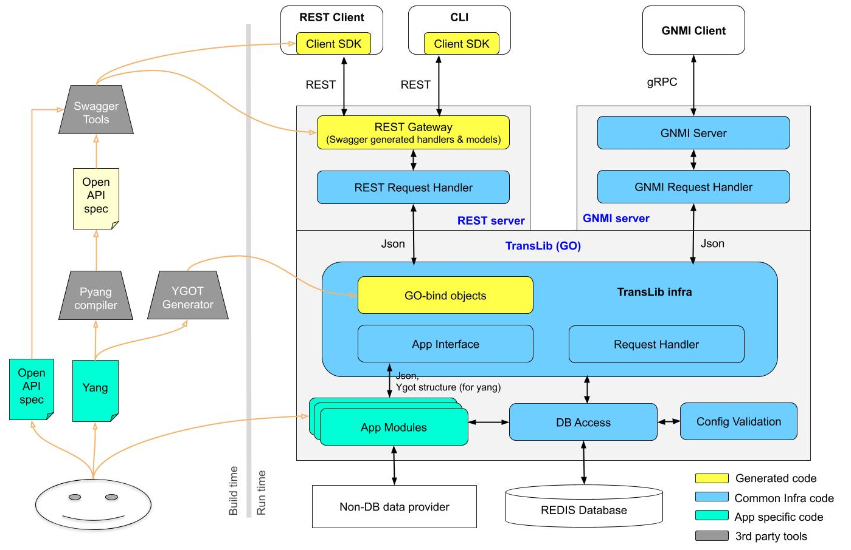
Design

Slide 5
REST Server
Swagger-codegen generated GO HTTP Server
API definitions:
Yang model defined RESTCONF APIs
OpenAPI spec defined REST APIs
Yang files are converted to OpenAPI spec and then fed to swagger-codegen
New pyang plugin to generate OpenAPI spec file from yang
Generates RESTCONF compliant GET, POST, PUT, PATCH and DELETE operations for each yang data nodes.
Input and output will be in IETF yang json format
Yang RPCs are ignored (future enhancement)

Slide 6
REST Server (...2)
Generated REST server code invokes TransLib APIs -- direct function call
Supports basic auth, token auth and AAA authentication
Uses Swagger-UI for providing documentation and test UI
Client SDK -- Swagger-codegen generated client code
HTTP method | TransLib API
GET | Get
POST | Create
PATCH | Update
PUT | Replace
DELETE | Delete

Slide 7
Translib
Functionality
Provides APIs for REST and gNMI server.
Translates northbound models to southbound SONiC Redis tables
High-level Workflow
Registration of all App Modules
Base path based App module invocation
Automatic conversion of path and payload to YGOT bindings
Defines APIs for App modules to implement
Provides DB wrapper APIs and watch keys support
Invokes the Config Validation Library(CVL) for command validation

Slide 8
TransLib APIs
App Interface functions
Create(req SetRequest) (SetResponse, error)
Update(req SetRequest) (SetResponse, error)
Replace(req SetRequest) (SetResponse, error)
Delete(req SetRequest) (SetResponse, error)
Get(req GetRequest) (GetResponse, error)
Subscribe(paths []string, q *queue.PriorityQueue, stop chan struct{}) (This might change)
GetModels() ([]ModelData, error)
initialize(data appData)
translateCreate(d *db.DB) ([]db.WatchKeys, error)
translateUpdate(d *db.DB) ([]db.WatchKeys, error)
translateReplace(d *db.DB) ([]db.WatchKeys, error)
translateDelete(d *db.DB) ([]db.WatchKeys, error)
translateGet(dbs [db.MaxDB]*db.DB) error
processCreate(d *db.DB) (SetResponse, error)
processUpdate(d *db.DB) (SetResponse, error)
processReplace(d *db.DB) (SetResponse, error)
processDelete(d *db.DB) (SetResponse, error)
processGet(dbs [db.MaxDB]*db.DB) (GetResponse, error)

Slide 9
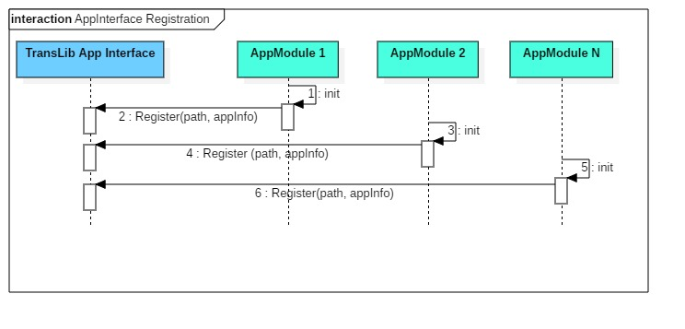
App Registration

Slide 10
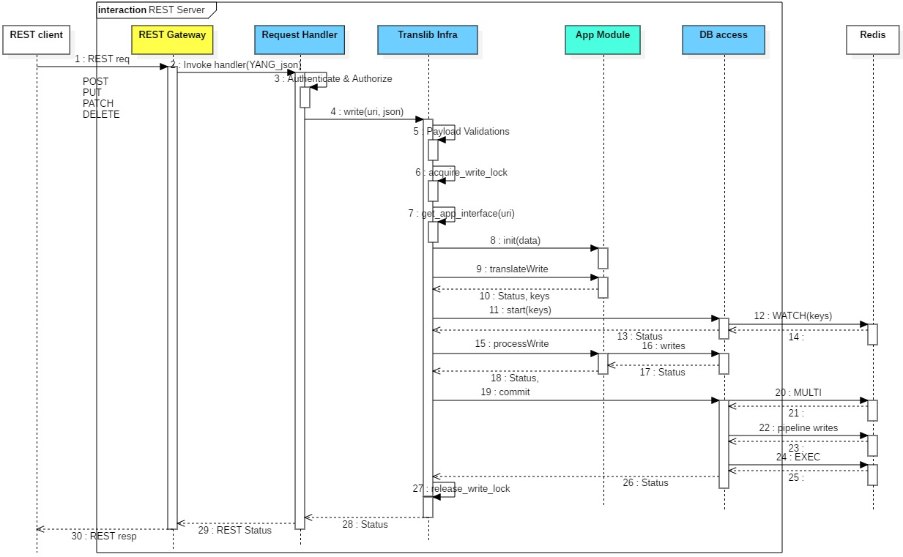
REST SET Operation

Slide 11
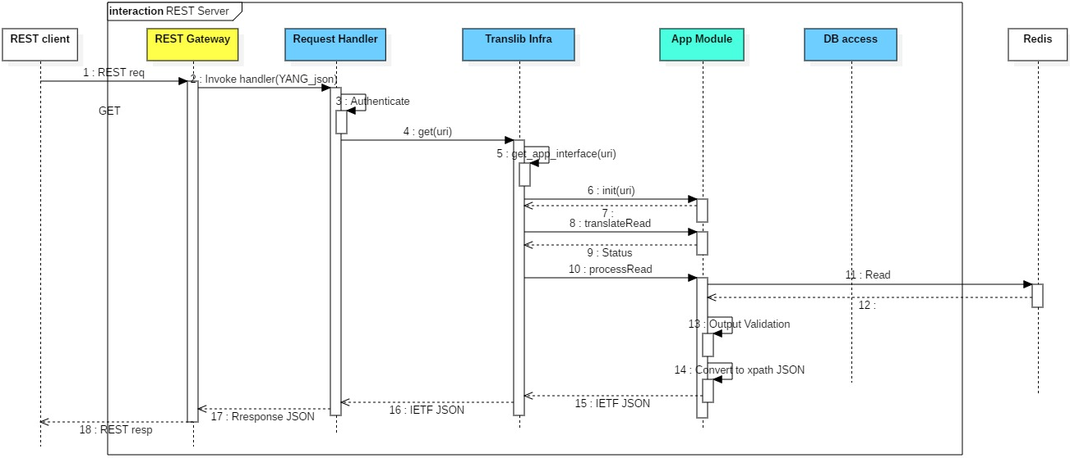
REST GET Operation

Slide 12
Translib Input/Output
Input:
type GetRequest struct {
Path string
}
type SetRequest struct {
Path string
Payload []byte
}
Output:
type GetResponse struct {
Payload []byte
ErrSrc ErrSource
}
type SetResponse struct{
ErrSrc ErrSource
}

Slide 13
App Modules
Translate northbound API data to native REDIS DB and vice versa
Should implement all functions of TransLib App Interface
Stateless
Should define a context object to hold request and intermediate data
TransLib initializes new instance of this object for each request
Automatically destroyed when the request processing is complete
Ygot bind objects to process standard yang data
Raw json (or any other format) for direct OpenAPI defined REST APIs

Slide 14
App Module Input
type appData struct {
path string
payload []byte
ygotRoot *ygot.GoStruct //Points to the device root structure of the yang tree
ygotTarget *interface{} //Points to the target structure inside the above root structure which is being requested/modified. In case of SET operation the payload is already filled inside this structure
}

Slide 15
App Module GET Sample
aclTableMap map[string]db.Value
ruleTableMap map[string]map[string]db.Value
func (acl *AclApp) processGet(dbs [db.MaxDB]*db.DB) (GetResponse, error) {
aclObj := acl.getAppRootObject()
if isSubtreeRequest(targetUriPath, "/openconfig-acl:acl/acl-sets") {
for aclSetKey,_ := range aclObj.AclSets.AclSet {
aclSet := acl.AclSets.AclSet[aclSetKey]
aclKey := aclSetKey.Name + "_" + aclSetKey.Type
if aclSet.AclEntries != nil && len(aclSet.AclEntries.AclEntry) > 0 {
for seqId,_ := range aclSet.AclEntries.AclEntry {
entrySet := aclSet.AclEntries.AclEntry[seqId]
acl.convertDbAclRulesToInternal(configDb, aclKey, seqId, db.Key{})
acl.convertInternalToOCAclRule(aclKey, aclSetKey.Type, seqId, nil, entrySet)
jsonStr, err = dumpIetfJson(entrySet)
}
}
}
}
return GetResponse{Payload: []byte(jsonStr)}, err
}
func (acl *AclApp) convertDbAclRulesToInternal(d *db.DB, aclName string , seqId uint32, ruleKey db.Key) error {
ruleKey = []string {aclName, "RULE_" + strconv.FormatInt(seqId, 10)}
ruleName := ruleKey.Get(1)
if ruleName != "DEFAULT_RULE" {
ruleData, err := d.GetEntry(&ruleTable, ruleKey)
if err != nil {
return err
}
ruleTableMap[aclName][ruleName] = ruleData
}
return err
}
func (acl *AclApp) convertInternalToOCAclRule(aclName string, aclType ocbinds.E_OpenconfigAcl_ACL_TYPE, seqId uint32, aclSet *ocbinds.OpenconfigAcl_Acl_AclSets_AclSet, entrySet *ocbinds.OpenconfigAcl_Acl_AclSets_AclSet_AclEntries_AclEntry) {
for ruleName := range ruleTableMap[aclName] {
ruleData := ruleTableMap[aclName][ruleName]
priority,_ := strconv.ParseInt(ruleData.Get("PRIORITY"), 10, 32)
seqId := MAX_PRIORITY - priority
ruleDescr := ruleData.Get("RULE_DESCRIPTION")
entrySet.Config.SequenceId = &seqId
entrySet.Config.Description = &ruleDescr
entrySet.State.SequenceId = &seqId
entrySet.State.Description = &ruleDescr
entrySet.Transport.Config.SourcePort = ruleData.Get("L4_SRC_PORT")
entrySet.Ipv4.Config.Dscp = ruleData.Get("DSCP")
...
...
}
}

Slide 16
App Module SET sample
aclTableMap map[string]db.Value
ruleTableMap map[string]map[string]db.Value
func (acl *AclApp) translateCreate(d *db.DB) ([]db.WatchKeys, error) {
aclObj := acl.getAppRootObject()
ruleTableMap = convertOCAclRulesToInternal(aclObj)
...
...
}
func (acl *AclApp) processCreate(d *db.DB) (SetResponse, error) {
SetAclRuleDataInConfigDB(d, ruleTableMap)
}
func convertOCAclRulesToInternal(acl *ocbinds.OpenconfigAcl_Acl) map[string]map[string]db.Value {
var rulesInfo map[string]map[string]db.Value
if acl != nil {
for aclSetKey,_ := range acl.AclSets.AclSet {
aclSet := acl.AclSets.AclSet[aclSetKey]
aclKey := aclSetKey.Name + "_" + aclSetKey.Type
if aclSet.AclEntries != nil {
for seqId,_ := range aclSet.AclEntries.AclEntry {
entrySet := aclSet.AclEntries.AclEntry[seqId]
ruleName := "RULE_" + strconv.FormatInt(int64(seqId), 10)
convertOCToInternalRule(rulesInfo[aclKey][ruleName], seqId, aclKey, aclSet.Type, entrySet)
}
}
}
}
return rulesInfo
}
func convertOCToInternalRule(ruleData db.Value, seqId uint32, aclName string, aclType ocbinds.E_OpenconfigAcl_ACL_TYPE, rule *ocbinds.OpenconfigAcl_Acl_AclSets_AclSet_AclEntries_AclEntry) {
ruleIndex := seqId
ruleData.Field["PRIORITY"] = strconv.FormatInt(int64(MAX_PRIORITY - ruleIndex), 10)
ruleData.Field["RULE_DESCRIPTION"] = *rule.Config.Description
ruleData.Field["DSCP"] = strconv.FormatInt(int64(*rule.Ipv4.Config.Dscp), 10)
ruleData.Field["SRC_IP"] = *rule.Ipv4.Config.SourceAddress
ruleData.Field["DST_IP"] = *rule.Ipv4.Config.DestinationAddress
...
...
}
func SetAclRuleDataInConfigDB(d *db.DB, ruleData map[string]map[string]db.Value) {
for aclName := range ruleData {
for ruleName := range ruleData[aclName] {
d.SetEntry(&ruleTable, db.Key{Comp: []string {aclName, ruleName} }, ruleData[aclName][ruleName])
}
}
}

Slide 17
DB access
Provides GO APIs to access the Redis DB. (Python SWSS SDK like)
DB Access Layer to Open/Close a DB Connection:
func NewDB(opt Options) *DB func (d *DB) DeleteDB() error
DB Access Layer to Get/Set/Delete/Update Entry:
func (d *DB) GetEntry(ts *TableSpec, key Key) (Value, error)
func (d *DB) GetKeys(ts *TableSpec) ([]Key, error)
func (d *DB) [Set|Mod]Entry(ts *TableSpec, key Key, value Value) error
func (d *DB) DeleteEntry(ts *TableSpec, key Key) error
DB Access Layer for Table Level Operations:
func (d *DB) GetTable(ts *TableSpec) (Table, error) func (d *DB) DeleteTable(ts * TableSpec) error
func (t *Table) GetKeys() ([]Key, error) func (t *Table) GetEntry(key Key) (Value, error)
DB Access Layer for Transaction:
func (d * DB) StartTx(watchKeys []WatchKeys) error func (d * DB) CommitTx() error func (d * DB) AbortTx() error

Slide 18
Config Validation Library (CVL)
Independent library to validate ABNF schema (Redis) based SONiC configuration
ABNF schema based YANG (SONiC data model) with constraints
ABNF schema has limitation in terms of expressing constraints
Custom YANG extension (annotation)
Validation Flow
ABNF JSON as input to the Translator (generic module) which generates YANG XML with the help custom YANG extension
Libyang uses the YANG XML to validate syntax and semantics as requested by generic CVL code
Custom validation for cases which needs special handling
Supports static and dynamic platform validation

Slide 19
CVL - Design
Click CLI
Translib
cfg-gen
Other App
ABNF JSON
ABNF Schema
Config Validation Library
Common Infra
Translator
(to YANG XML)
YANG Schema with metadata
Syntax Check
libyang
Platform Specific Data
Pyang Compiler
YIN Schema with metadata
Semantic Check
Platform Check
Custom Validation
Build Time
Run Time
Redis DB
Common code
Third party
Generated
Feature specific custom code
Manually written
Applications

Slide 20
CVL - Platform Constraints Validation
There can be two types of platform constraint validation:
Static Platform Constraint Validation
Platform constraints (range, enum, ‘must’/’when’ expression etc.) are expressed in YANG deviation model for each feature.
Deviation models are compiled along with SONiC feature YANG model and new constraints are added or overwritten in the compiled schema.
Dynamic Platform Constraint Validation
Platform data is available in Redis DB table.
SONiC YANG models can be developed based on platform specific data in Redis DB. Constraints like ‘must’ or ‘when’ are used in feature YANG by cross-referencing platform YANG models.
Platform data is available through APIs
If constraints cannot be expressed using YANG syntax or platform data is available through API, custom validation needs to be hooked up in feature YANG model through custom YANG extension.
CVL will generate stub code for custom validation. Feature developer implements the stub code. The validation function should call platform API and fetch required parameter for checking constraints.
Based on YANG extension syntax, CVL will call the appropriate custom validation function along with YANG instance data to be validated.

Slide 21
CVL - Sample schema
container sonic-acl {
scommon:db-name "CONFIG_DB";
list ACL_TABLE {
key "aclname";
scommon:key-delim "|";
scommon:key-pattern "ACL_TABLE|{aclname}";
leaf aclname {
type string;
}
leaf-list ports {
type leafref {
path "/prt:sonic-port/prt:PORT/prt:ifname";
}
}
......
}
list ACL_RULE {
key "aclname rulename";
scommon:key-delim "|";
scommon:key-pattern "ACL_RULE|{aclname}|{rulename}";
scommon:pf-check “ACL_CheckAclRuleLimit”;
leaf aclname {
type leafref {
path "../../ACL_TABLE/aclname";
}
}
leaf rulename {
type string;
}
leaf MIRROR_ACTION {
type leafref {
path "/sms:sonic-mirror-session/sms:MIRROR_SESSION/sms:name";
}
}
......
}
}
ABNF JSON:
"ACL_RULE": {
"TestACL1|Rule1": {
"PACKET_ACTION": "FORWARD",
"SRC_IP": "10.1.1.1/32",
"L4_SRC_PORT": "10078",
"IP_PROTOCOL": "103",
"DST_IP": "20.2.2.2/32",
"L4_DST_PORT_RANGE": "9000-12000"
}
}
}
YANG XML:
<sonic-acl xmlns="http://github.com/Azure/sonic-acl">
<ACL_RULE>
<aclname>TestACL1</aclname>
<rulename>Rule1</rulename>
<DST_IP>20.2.2.2/32</DST_IP>
<IP_PROTOCOL>1</IP_PROTOCOL>
<L4_DST_PORT_RANGE>9000-12000</L4_DST_PORT_RANGE>
<L4_SRC_PORT>8080</L4_SRC_PORT>
<PACKET_ACTION>FORWARD</PACKET_ACTION>
<SRC_IP>10.1.1.1/32</SRC_IP>
</ACL_RULE>
</sonic-acl>

Slide 22
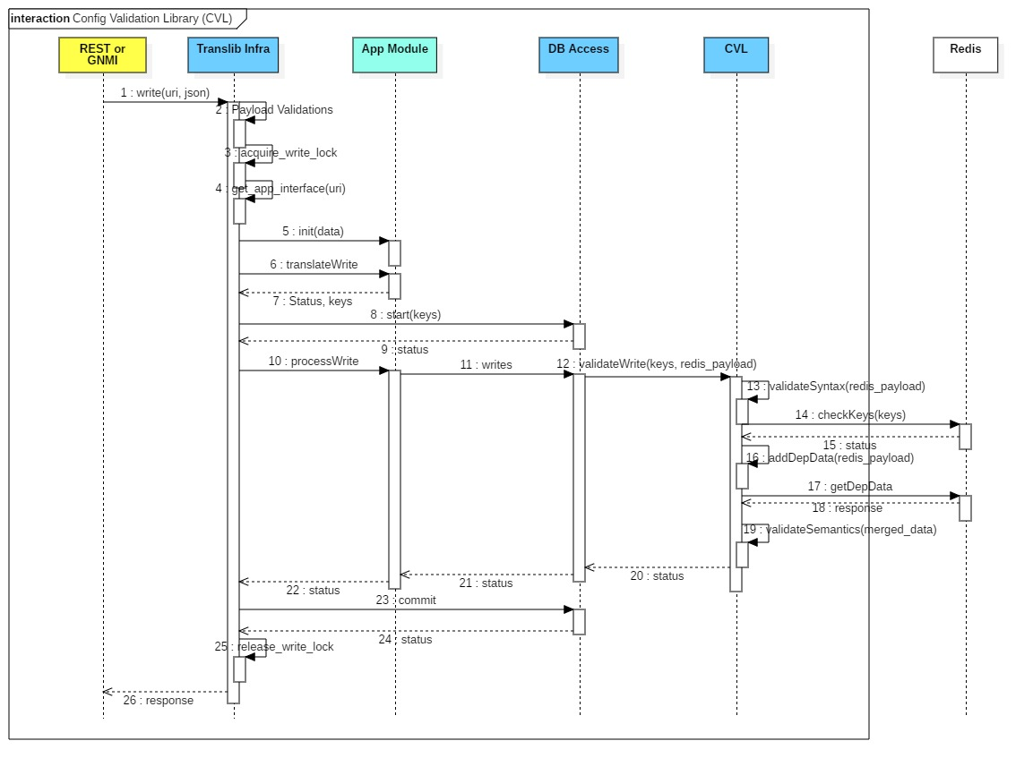
CVL - Sequence Diagram
Note: Redis DB interaction from DB Access layer is not shown here for brevity, refer to Slide #6 - REST SET OPERATION

Slide 23
CLI for SONiC

Slide 24
Overview
Use Open Source Klish to support industry standard CLI
Extend Klish parser with patches to allow advanced cases like recursive parameter etc.
Use Swagger client SDK to execute CLI commands
Template Rendering with Python Jinja
Provide the reference XML files for CLI command tree to allow SONiC community to easily customize CLI commands

Slide 25
CLI modules
CLI
CLI command Tree
REST
API
Rest Server
Actioner
3
1
2
Klish
6
Render
5
4

Slide 26
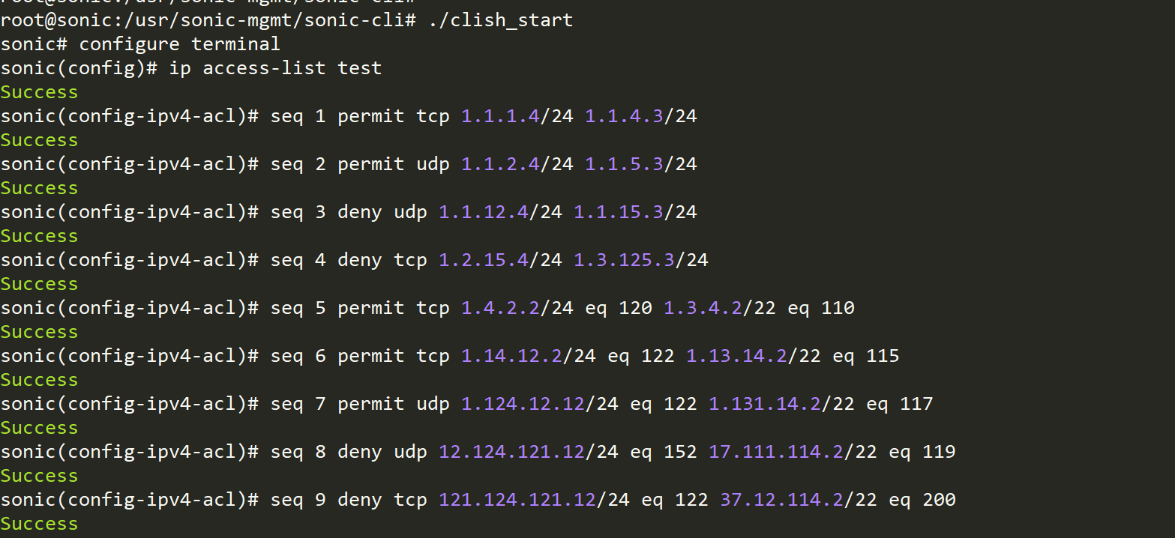
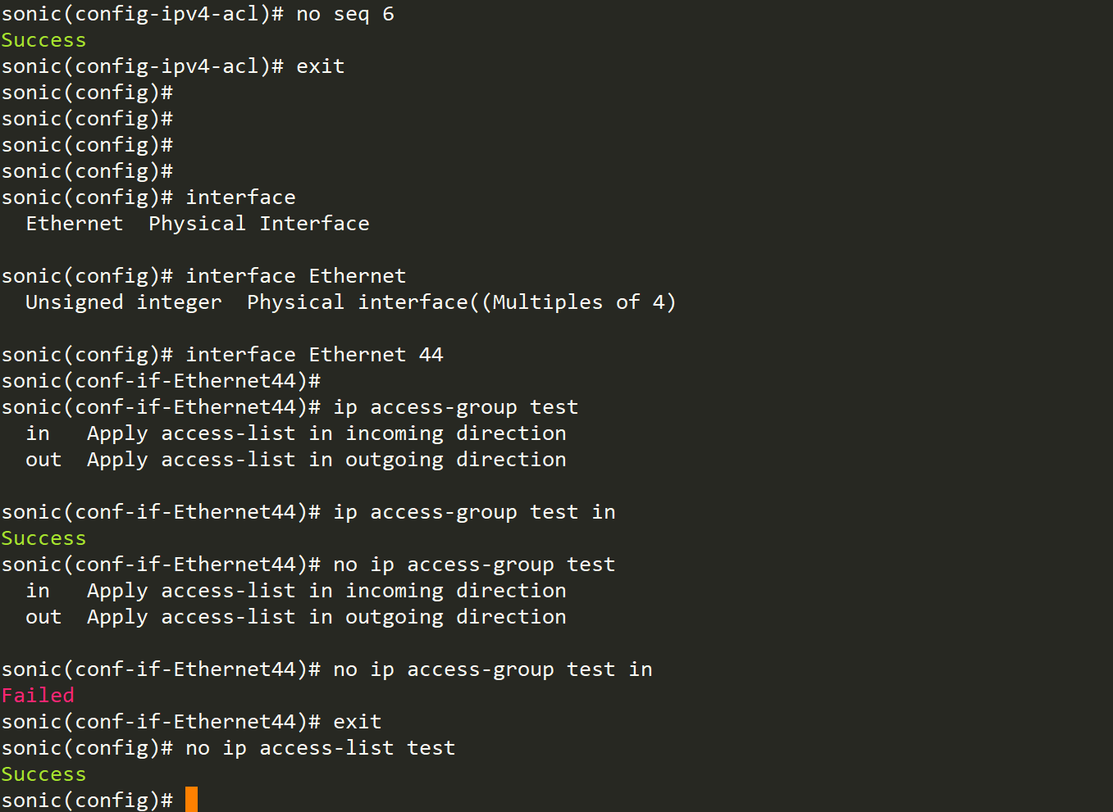
CLI examples – ACL

Slide 27
gNMI Server Integration
gNMI Collector (Client)
sonic-telemetry
gNMI Server
gRPC Dial-in Server
Dial-out Client
Request Handler
Existing path
Get
Subscribe
Capability
Set
New path
Existing common code
DB / Non-DB Client
TransL Data Client
New common code
Existing service extended based on Yang model
TransL Utils
New service based on Yang model
TransLib
App specific code
App Modules
Non-DB data provider
Redis database

Slide 28
PoC - A Brief View

Slide 29
Scope of PoC
Use cases considered
Open Config ACL
Get
Create
Delete
OpenAPI Spec for sample VLAN configuration
Management applications for these use cases
REST
gNMI
CLI

Slide 30
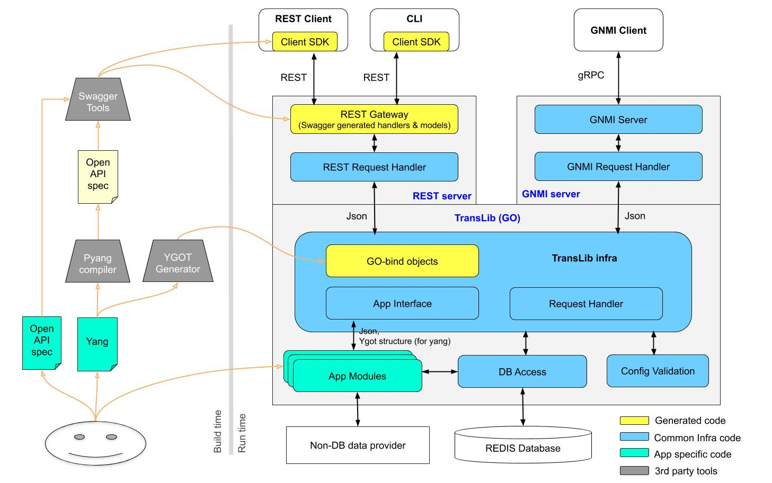
PoC - Detailed View
Klish based hierarchical CLIs
- ACL create/delete
- Add/remove rule to ACL
- Bind ACL on interface
Swagger UI
Swagger-codegen templates and command one tools to generate server code
GET and SET operations based on OpenConfig ACL model
Pyang plugin to generate OpenAPI spec from yang
Stock OpenConfig ACL ygot bindings
A demo OpenAPI spec with VLAN ops - get, create, delete, add/rem members
CVL in GO lang
Schema models for ACL, Rule, vlan and vlan member tables
OpenConfig ACL yang -- create/del ACLs, rules and bind/unbind interface
Demo apps:
1) OpenConfig ACL yang operations
2) Sample VLAN configs (non-yang)
Python swsssdk like APIs in GO lang
Integrates with CVL

Slide 31
Backup

Slide 32
Design contd ...
Pyang Compiler
An extensible YANG validator and OpenAPI Spec generator.
YGOT Generator
Collection of Go utilities for generating Go Structures, validating contents in the Go structures, rendering Go Structure to output format such as JSON.
Swagger Tool
Generates Client SDK, Server Stub and API documentation based on OpenAPI Spec.
Client SDK
Swagger generated APIs used to communicate with REST server from a REST client/CLI.
REST Gateway (Server)
GO based REST server generated using swagger.
REST Request Handler
All REST requests from Northbound land here
Invokes common handler for CRUD operations with path and Payload
Calls appropriate Translib functions based on CRUD operation.
GNMI Server
Existing GNMI server in SONiC extended for YANG based support
GNMI Request Handler
Handles Set/Get/Subscribe/Capability request.
Calls appropriate Translib functions based on requested operation

Slide 33
Design contd ...
TransLib (GO)
GO based Translation library to convert data in YANG to Redis(ABNF) format and vice versa, validate config data and write to Redis/Non-DB database.
Translib Infra
GO bind-Objects
GO bindings generated using YGOT. Converts the incoming payload to YGOT structures, which is given to App modules
Request Handler
All requests from management servers land here.
App Interface
App modules registers with it dpathng TransLib initialization
Invokes appropriate app module specific implementation
App Modules
YGOT structure to ABNF key value pairs - write, ABNF key value pairs to YGOT structure - read
Translates, validates and converts data.
Facilitates breaking bulk operation into multiple operations suitable for Redis transaction
DB Access
Provides access to Redis DB using Go-Redis package
Supports transaction
Config Validation
Validates a JSON buffer against given ABNF schema. Carries-out semantic, syntactic, parameter, type and range validation as well as platform and inter-dependency validation. Uses code generated from a schema definition

Slide 34
Config Validation Library (CVL) contd...
API List :
type KeyData struct {
Key string //Key format : “PORT|Ethernet4”
Data map[string]string //Value : {“alias”: "40GE0/28", “mtu” : 9100, “admin_status”: down}
}
Initialize()
Finish()
ValidateConfig(jsonData string)
ValidateCreate(keyData []KeyData)
ValidateUpdate(keyData []KeyData)
ValidateDelete(keyData []KeyData)
ValidateKey(key string)
ValidateField(key, field, value string)

Slide 35
Config Validation Library (CVL) contd...
ValidateUpdate([{
"ACL_TABLE|TestACL1", {
"stage": "EGRESS",
}
},
{"ACL_RULE|TestACL1|Rule1", {
"src_ip": "9.1.1.1/32",
"l4_src_port": 8081,
}
}])
ValidateDelete([{
"ACL_TABLE|TestACL1", { }
},
{"ACL_RULE|TestACL1|Rule1", { }
}])
ValidateConfig(`{
"VLAN": {
"Vlan100": {
"members": [
"Ethernet44", "Ethernet64"
],
"vlanid": "100"
},
"Vlan1200": {
"members": [
"Ethernet64","Ethernet8"
],
"vlanid": "1200"
}
},
"VLAN_MEMBER": {
"Vlan100|Ethernet924": {
"tagging_mode": "tagged"
},
"Vlan1200|Ethernet4": {
"tagging_mode": "tagged"
}
},
"WRED_PROFILE": {
"AZURE_LOSSLESS": {
"red_max_threshold": "312000",
"wred_green_enable": "true",
"ecn": "ecn_all",
"green_min_threshold": "104000",
"red_min_threshold": "104000",
"wred_yellow_enable": "true",
"yellow_min_threshold": "104000",
"wred_red_enable": "true",
"yellow_max_threshold": "312000",
"green_max_threshold": "312000"
}
},
"MIRROR_SESSION": {
"everflow0": {
"src_ip": "10.1.0.32",
"dst_ip": "2.2.2.2"
}
}
})
ValidateCreate([{
"ACL_TABLE|TestACL1", {
"stage": "INGRESS",
"type": "l3"
}
},
"ACL_TABLE|TestACL2", {
"stage": "EGRESS",
"type": "l3"
}
},
{"ACL_RULE|TestACL1|Rule1", {
"packet_action": "forward",
"src_ip": "10.1.1.1/32",
"l4_src_port": 8080,
"ip_protocol": "ip",
"dst_ip": "20.2.2.2/32",
"l4_dst_port_range": "9000-12000"
}
}])

Slide 36
CVL - Deviation YANG model
Feature YANG model
list VLAN {
scommon:db-name "CONFIG_DB";
key "name";
scommon:key-delim "|";
scommon:key-pattern "VLAN|{name}";
must "./name = concat('Vlan', string(./vlanid))";
leaf name {
type string {
pattern "Vlan(409[0-5]|40[0-8][0-9]|[1-3][0-9]{3}|[1-9][0-9]{2}|[1-9][0-9]|[1-9])";
}
}
...
}
YIN Schema
<container name="sonic-vlan">
<list name="VLAN">
<scommon:db-name value="CONFIG_DB"/>
<key value="name"/>
<scommon:key-delim value="|"/>
<scommon:key-pattern value="VLAN|{name}"/>
<must condition="./name = concat('Vlan', string(./vlanid))"/>
<leaf name="name">
<type name="string">
<pattern value="Vlan([1-3][0-9]{3}|[1-9][0-9]{2}|[1-9][0-9]|[1-9])"/>
</type>
</leaf>
<leaf name="vlanid">
<type name="uint16"/>
</leaf>
……
……
……
</container>
Deviation YANG model
deviation /svlan:sonic-vlan/svlan:VLAN/svlan:name {
deviate replace {
type string {
/* Supports 3K VLANs */
pattern "Vlan([1-3][0-9]{3}|[1-9][0-9]{2}|[1-9][0-9]|[1-9])";
}
}
}

Slide 37
CVL - Platform constraints in Redis DB
Feature YANG model:
list ACL_RULE {
key "aclname rulename";
scommon:key-delim "|";
scommon:key-pattern "ACL_RULE|{aclname}|{rulename}";
must "count(../ACL_RULE) > /spf:sonic-pf-limits/acl/MAX_ACL_RULES" {
error-message "Number of ACL rules reached max platform limit.";
}
must "PRIORITY > /spf:sonic-pf-limits/acl/MAX_PRIORITY" {
error-message "Invalid ACL rule priority.";
}
leaf aclname {
type leafref {
path "../../ACL_TABLE/aclname";
}
}
leaf rulename {
type string;
}
leaf PRIORITY {
type uint16 {
range "1..65535";
}
}
........
}
Platform data YANG model:
container sonic-pf-limits {
scommon:db-name "APPL_DB";
container acl {
leaf MAX_ACL_RULES {
type uint16;
}
leaf MAX_PRIORITY {
type uint16 {
range "1..65535";
}
}
}
container vlan {
leaf MAX_VLANS {
type uint16;
}
}
}
Platform data in Redis DB:
{ sonic-pf-limits : {
acl: { “ MAX_ACL_RULES” : 1024, “MAX_PRIORITY”: 2500 } ,
vlan: {“MAX_VLANS “: 3000}
} }

Slide 38
CVL - Platform constraints through APIs
Feature YANG model:
list ACL_RULE {
key "aclname rulename";
scommon:key-delim "|";
scommon:key-pattern "ACL_RULE|{aclname}|{rulename}";
scommon:pf-check "ACL_CheckAclRuleLimit";
leaf aclname {
type leafref {
path "../../ACL_TABLE/aclname";
}
}
leaf rulename {
type string;
}
leaf PRIORITY {
type uint16 {
range "1..65535";
}
}
........
}
Custom Validation Plugin code:
func ACL_CheckAclRuleLimit(node) bool {
curNumACLRules := NumberOfNodes(node.Parent) //Get current number of ACL rules
maxACLRule := PF_ACL_GetMaxACLRules() //Call platform specific API
if (curNumACLRules <= maxACLRule) {
return true
}
return false
}

Slide 39
gNMI Integration
Approach :
If path ‘Prefix’ is any of known DB name like APP_DB, CONFIG_DB etc., existing data client is created.
For other cases, new TransL data client is created.
TransL data client uses TransL Utils functions.
TransL Utils functions invoke APIs provided by TransLib library.
TransLib API creates thread internally per client subscription which listens for Redis notification. The notification data is received by TransL data client through.
Code organization:
├── dialout
│ ├── dialout_client
│ │ ├── dialout_client.go ⇒ Modified
│ │ └── dialout_client_test.go
│ ├── dialout_client_cli
│ └── dialout_client_cli.go
├── gnmi_server
│ ├── client_subscribe.go ⇒ Modified
│ ├── server.go ⇒ Modified
│ └── server_test.go
├── sonic_data_client
│ ├── db_client.go
│ ├── non_db_client.go
│ ├── transl_data_client.go ==> Added TransL data client
│ ├── trie.go
│ └── virtual_db.go
└── transl_utils
└── transl_utils.go ==> Added TransL Utils Layer

